Slide 1
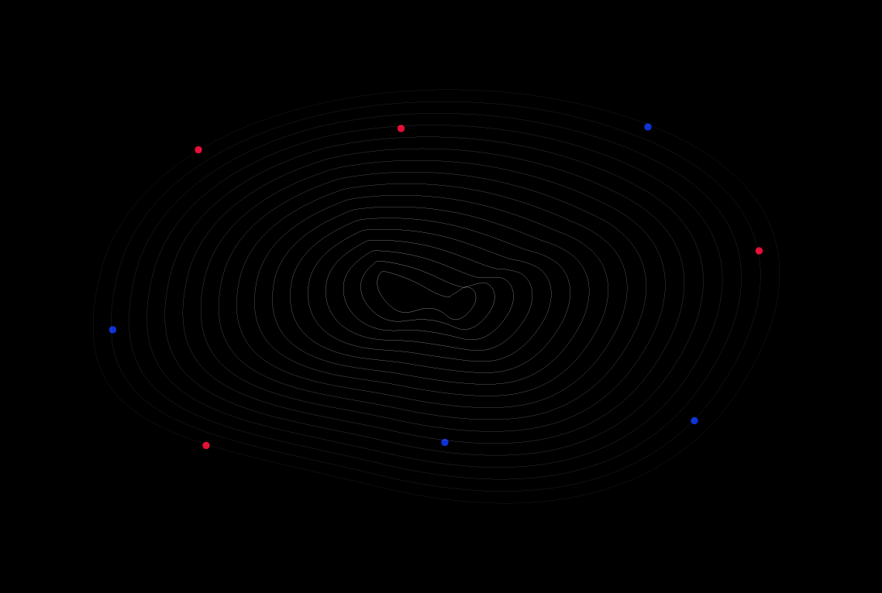
Welcome To
GoMyCode

Slide 2
Web Fundamentals

Slide 3
Introduction
Front-end
Back-end
HTML
CSS
JavaScript
React JS
NodeJS
Express
MongoDB
Request
Response

Slide 4
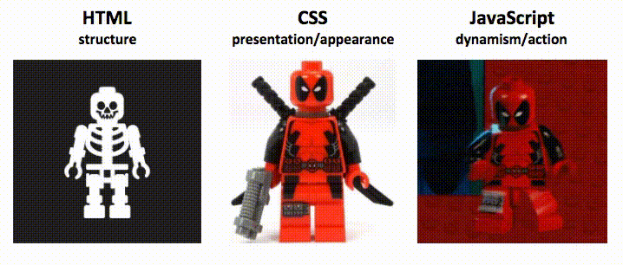
Notes:
Javascript yrod la page dynamique
Na7na chnerakzou 3al HTML w CSS 5ater el nes elkol yesta3louhom
Par contre el javascript 3andou des alternatives o5rin ama houa men akthar les languages el tal3in taw

Slide 5

HTML is a markup language that builds the structure and gives us the skeleton of our website or web app

Slide 6

CSS is a style sheet language that’s responsible for the design and the appearances of our website or web application

Slide 7

JavaScript adds dynamism and interactivity to our website or web application

Slide 8

React is a JavaScript library created by Facebook in 2013 that will make our lives much easier as we will see in future courses...

Slide 9


Slide 10
Thank you for your time and have a great journey!

